Slide 2
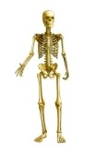
Better foundations
Bones give your body shape and definition
Made from calcium and other minerals
Most (99 per cent) is stored in bones and teeth
The rest is found in blood and in cells
Notes:
Bones Made from calcium and other minerals. Most of our calcium (99 per cent) is stored in bones and teeth, the rest is found in blood and in cells

Slide 3
Calcium: other functions
Muscle contraction
Nerve conduction
Blood coagulation
Hormone release
Energy production
Immunity
Notes:
As well as building bones and teeth, calcium is essential for a range of functions….

Slide 4
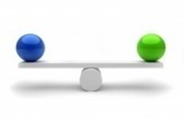
A constant internal environment
Your body tries hard to keep calcium levels in the blood to within very narrow concentrations. If blood calcium levels fall short, it is taken from the bank in your bones.
Notes:
Calcium is involved in homeostasis – the maintenance of a constant internal environment. Your body tries hard to keep calcium levels in the blood to within very narrow concentrations. If blood calcium levels fall short, it is taken from the bank in your bones.

Slide 5
Too many calcium withdrawals
Not banking enough calcium and taking too much out of it weakens your bones.
Notes:
Your body needs enough calcium to build bone and maintain its strength all of your life. Not getting enough means that the body takes calcium out of the stores in your bones which over time weakens them.

Slide 6
ages, stages and needs
Getting enough calcium is a vital whatever your age.
Children/teens need it to maximise bone density.
USANA research: building bone mass by just five per cent in teen years can cut osteoporosis risk by 40 per cent.
Notes:
Getting enough calcium is a vital whatever your age. Children/teens need it to maximise bone density. Maximum bone mass is reached around early to mid twenties. Getting the optimum amount of calcium in the developing years means that the skeleton will be at its greatest mass – the strongest it can be.
USANA research: building bone mass by just five per cent in teen years can cut osteoporosis risk by 40 per cent.
1. Wood T, McKinnon T. Calcium- Magnesium- Vitamin D Supplementation Improves Bone Mineralization in Preadolescent Girls. USANA Clinical Research Bulletin 2001 Feb; No. 8. http://www.usana.com/media/File/dotCom/company/science/crb/8CRB.pdf

Slide 7
After 30
Your body naturally starts to lose bone mass.
Around menopause, calcium losses are greater due to hormonal changes.
Women have a smaller frame to begin with.
All these increase the risk of osteoporosis.
Notes:
After thirty or so, the bones start to get weaker as minerals are lost from the body.
For about the first five years after menopause, women lose bone at the rate of about 2%–3% per year and then continue to lose about 1% of bone mass per year to the end of life

Slide 8
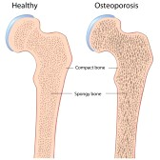
Age effects…
It gets more difficult to absorb calcium effectively from the gastro intestinal tract. And, calcium losses in urine increase. Both factors affect calcium status.
Notes:
The increasing difficulty in absorbing calcium, increased breakdown plus greater loss in urine increase the chances of weaker bones.

Slide 9
Men and osteoporosis
Calcium and bone health is important for men, too.
Around one in four older men has osteoporosis.
Notes:
Men are affected by osteoporosis, too. Around one in four older men has osteoporosis

Slide 10
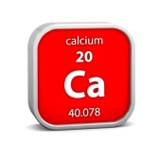
Your calcium needs
Most adults need around 1000-1300 mg calcium from food and/or supplements daily. Enjoying a diet that contains enough calcium is important.
Notes:
Most adults need around 1000-1300 mg calcium from food and/or supplements daily

Slide 11
Good sources
Low-fat dairy products such as milk, yoghurt, cheese???
Leafy green vegetables, broccoli
Almonds
Soy milk and soy products and foods fortified with calcium.
Notes:
Animal protein—in fish, poultry, red meat, eggs, and dairy products acidifies the body pH which in turn triggers a biological correction. Calcium is an excellent acid neutralizer and the biggest storage of calcium in the body is the bones. So the very same calcium that our bones need to stay strong is utilized to neutralize the acidifying effect of milk. Once calcium is pulled out of the bones, it leaves the body via the urine, so that the surprising net result after this is an actual calcium deficit. Plant protein—in beans, grains, and vegetables—does not appear to have this effect.⁴4. Holick MF, Garabedian M: Vitamin D: photobiology, metabolism, mechanism of action, and clinical applications. In Primer on the metabolic bone diseases and disorders of mineral metabolism. 6th edition. Edited by Favus MJ. Washington, DC: American Society for Bone and Mineral Research; 2006::129-137.
Aim for three servings of dairy or calcium-fortified foods each day. Absorption from soy milk can be, but is not always, as high as that from cow’s milk

Slide 12
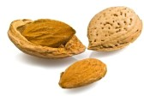
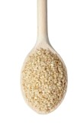
non-dairy calcium
1. Calcium-fortified drinks such as soy milk
3. Canned salmon/sardines
5. Sesame seeds – plus products made with them e.g. tahini
2. Leafy green veggies – kale, spinach, bok choy
4. Tofu
Notes:
Products that contain calcium citrate and malate may be easier for your body to absorb than calcium phosphate and calcium lactate.

Slide 13
Not so good for bones
Inactivity, smoking , drinking too much alcohol and too much salt can cause mineral loss from your bones. So can some medicines such as prednisolone.
Notes:
If you smoke, bone loss is more pronounced and more rapid. Smoking does this by affecting the hormonal balance, the liver produces more oestrogen-destroying enzymes causing loss of bone density. Smoking also increases cortisol which impedes the bone-building hormone, calcitonin.
Sodium affects urinary calcium excretion. A high salt intake has been associated with lower bone mass in some studies.

Slide 14
Exercise builds bone
Weight-bearing exercise encourages bone building cells. Exercise increases muscle mass, strength, balance, reduces the risk of falls and fractures.
Exercise has regional effects, supplements have generalised effects.
Notes:
Bones and muscles work against gravity stimulates bone production. Exercise produces region-specific effects, whereas higher calcium intake produces a more generalised effect in addition to the benefits of exercise

Slide 15
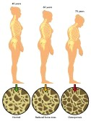
enough calcium?
According to the Australian Nutrition Survey, about 90 per cent of women and 70 per cent of children don’t consume the recommended dietary intake (RDI) for calcium.
Notes:
According to the Australian Nutrition Survey, about 90 per cent of women and 70 per cent of children don’t consume the recommended dietary intake (RDI) for calcium

Slide 16
Calcium supplements…
Can’t replace a healthy diet. But, they can bridge the nutritional gap. Over 40 per cent of people who take nutritional supplements opt for bone-building calcium.
Notes:
Can’t replace a healthy diet. But, they can bridge the nutritional gap. Over 40 per cent of people who take nutritional supplements opt for bone-building calcium.

Slide 17
According to Osteoporosis Australia…
Taking calcium supplements, especially with magnesium and/or vitamin D is safe.
Notes:
According to Osteoporosis Australia Taking calcium supplements, especially with magnesium and/or vitamin D is safe.

Slide 18
Active Calcium Plus
Active Calcium PlusTM is a carefully formulated, clinically proven bone-building formula. It provides comprehensive support for bone health and contains sufficient calcium, magnesium, and vitamin D to meet nutritional needs.
Notes:
As with all Usana products, Dr Wentz has carefully formulated Active Calcium Plus with the right forms, amounts and ingredients so they work in synergy together for the best bio availibilty and absorption. It is a clinically proven bone-building formula

Slide 19
Calcium and vitamin D
Reduces the rate of bone loss and fracture in people who don’t get enough calcium via diet.
Improves the effectiveness of osteoporosis medicines in people who have already been diagnosed with osteoporosis.’ (OA 2012)
Notes:
Calcium and vitamin D reduce the rate of bone loss and fracture in people who don’t get enough calcium via diet and improves the effectiveness of osteoporosis medicines in people who have already been diagnosed with osteoporosis.’ (OA 2012)

Slide 20
Safe calcium
Active Calcium Plus™ is a great choice because it is more than a calcium supplement; it is a carefully formulated, clinically proven
bone-builder.
Notes:
Active Calcium Plus™ is a great choice because it is more than a calcium supplement; it is a carefully formulated, clinically proven
bone-builder.

Slide 21
Effective calcium
The formulation incorporates magnesium with the calcium, a combination that ensures more calcium enters the bloodstream and isn’t deposited in the arteries or soft tissue.
Notes:
The formulation incorporates magnesium with the calcium, a combination that ensures more calcium enters the bloodstream and isn’t deposited in the arteries or soft tissue. It is important that this ratio , being 2:1 is used for optimum absorption and bioavailabilty

Slide 22
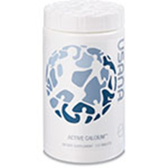
Active Calcium
Active Calcium Plus ™
Contains vitamins and minerals needed for bone health; the cofactors complement each other to provide efficient absorption.
Notes:
Active Calcium Plus ™
Contains vitamins and minerals needed for bone health; the cofactors complement each other to provide efficient absorption

Slide 23
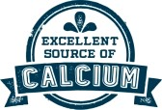
Two kinds of calcium
Calcium carbonate and calcium citrate for the best delivery of essential calcium in the smallest tablet.
Each tablet provides 200mg calcium per tablet to support a healthy diet that includes calcium-rich foods and your daily Essentials™.
Notes:
Active Calciam Plus has Calcium carbonate and calcium citrate for the best delivery of essential calcium in the smallest tablet. Each tablet provides 200mg calcium per tablet to support a healthy diet that includes calcium-rich foods and your daily Essentials™. Efficiency of absorption of calcium from supplements is greatest at doses of 500mg so try taking two tablets twice a day with meals.

Slide 24
Vitamin D
Partners with calcium helping your body absorb it and make bone. Stimulates DNA in the intestines to produce proteins that increase the amount of calcium that can be absorbed. Decreases the amount of calcium lost from the body in urine.
Notes:
Vitamin D is actually a hormone that is crucial for bone health. It stimulates DNA in the intestines to produce more proteins that increase the amount of calcium that can be absorbed. Additionally, vitamin D acts to decrease the amount of calcium processed by the kidneys and eliminated from the body in urine.

Slide 25
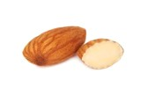
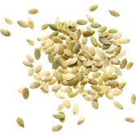
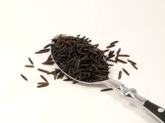
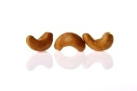
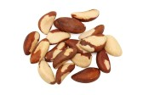
Magnesium
Must be present to convert vitamin D into its active form and turn on calcium absorption.
Helps reduce bone breakdown.
Helps calcium absorption in the bones instead of collecting in
soft tissue.
Find it in nuts, seeds, fish,
lentils and beans.
Notes:
Magnesium is essential to convert vitamin D into its active form so that it can turn on calcium absorption. It helps to reduce the bone breakdown and slows down bone turnover thus (reducing loss of bone density).
Manesium is vital to ensure that help calcium is absorbed in the bones instead of collecting in soft tissue where it can cause health problems.
Taking extra magnesium may help ease cramps and relieve constipation, headaches, great for sleep!!! especially when calcium supplements (formulated without magnesium) are the cause.
You find magnesium in nuts, seeds, lentils and beans.

Slide 26
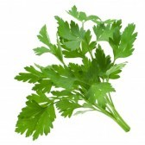
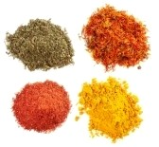
Vitamin K
Essential for bone health.
Studies show higher vitamin K levels equal lower osteoporosis risk.
Activates the proteins responsible for removing circulating calcium from the arteries and binding it to the bone.
Notes:
Vitamin K is Essential for bone health. Studies show higher vitamin K levels equal lower osteoporosis risk. Vitamin K activates the proteins responsible for removing circulating calcium from the arteries and binding it to the bone. It therefore influences the level of bone-building osteocalcin in bone-forming cells and helps to support bone strength.
Vitamin k can be found in Kale, broccoli, asparagus, Brussels sprouts, parsley chilli powder, curry powder, paprika and ground coriander.

Slide 27
Active calcium plus
Active Calcium Plus™ carries USANA’s Potency guarantee so you know the product is pure, safe, and effective. So, to boost your bone health, give Active Calcium a try!
USANA Active Calcium Plus™ (112 tablets/bottle)
Active Calcium Plus™ is:
Laboratory tested, quality guaranteed. Meets British Pharmacopoeia specifications for potency, uniformity, and disintegration where applicable.
Using Active Calcium Plus™
Take four (4) Active Calcium Plus tablets daily, preferably with meals.
Notes:
Active Calcium Plus™ carries USANA’s Potency guarantee

Slide 28
Thanks for listening!
©USANA Australia New Zealand
Please do not amend this
presentation without permission from:
USANA Health Sciences,
3 Hudson Avenue,
Castle Hill 2154,
New South Wales, Australia
ravinder.lilly@au.usana.com

